Slide 1
Regional Comparisons and Socioeconomic Predictors of Obesity in the US
Tarif Ahmed Vincent Caruso

Slide 2
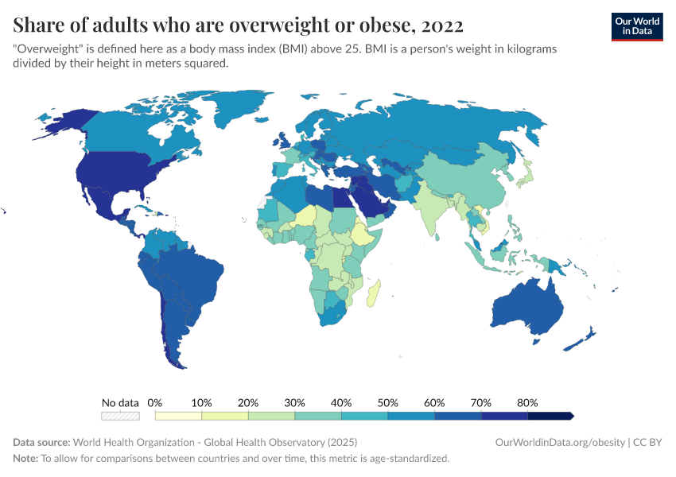
Background - problem statement
Obesity is a huge issue in America that is only getting larger
It raises the likelihood of chronic illnesses and premature mortality
The US consistently ranks in the top 10 most obese countries
Notes:
Tarif

Slide 3
Key Statistics (20 years)
30.5%
41.9%
Obesity also causes strain to the healthcare system and raises the medical costs for those afflicted
Significant disparities are observed based on race/ethnicity, education, and age
Increase in general obesity prevalence
4.7%
9.2%
Increase in severe obesity prevalence
Notes:
Tarif

Slide 4
Objective
Obesity is often examined on a country-level scale
When examining obesity at the international level, we must overcome the confound that other countries’ obesity rates are also fluctuating
To combat obesity, we first need to understand which regions and demographics are most affected
  Our analysis examines obesity patterns between 2011 and 2023
Our analysis will unpack regional and demographic differences in obesity and examine how rates for each group were affected by COVID-19
Notes:
Tarif

Slide 5

Dataset Background and Reliability
Datasource: Center for Disease control and prevention (CDC)
Dataset: The Nutrition, Physical Activity, and Obesity - Behavioral Risk Factor Surveillance System (BRFSS)
Outlines obesity trends across years, states, and demographic groups
Each row represents a aggregated statistical estimate from the CDC’s BRFSS
Datasize: 106K records, 33 variables
Methodology: Peer reviewed analysis
Key update: Metrics was refined to align with current physical activity guidelines
Notes:
Tarif

Slide 6

Filtering Data
Utilized four key variables:
  Temporal: YearStart, YearEnd
  Geographic: LocationDesc
  Health Metric: Questions
Systematically removed records with NULL values
Temporal Framework: Focus on three interval
  2011-2013, 2016-2018, 2021-2023
Each row represents a survey aggregate assessing the proportion of 18+ respondents who are obese
  Represented as a proportion alongside the sample size
Notes:
Tarif

Slide 7

COVID - 19 Context
To account for the impact of COVID-19, we analyzed three different timeframes
Data collection stopped during the COVID-19 pandemic lockdowns, providing unique statistical opportunities and challenges
  It prevents us from examining strictly temporal changes between time points
  It allows us to compare the usual rates (early to middle) with the changes leading into COVID lockdowns (middle to late)
Enabled us to observe the deviation caused by COVID-19 lockdown
Notes:
Vincent

Slide 8
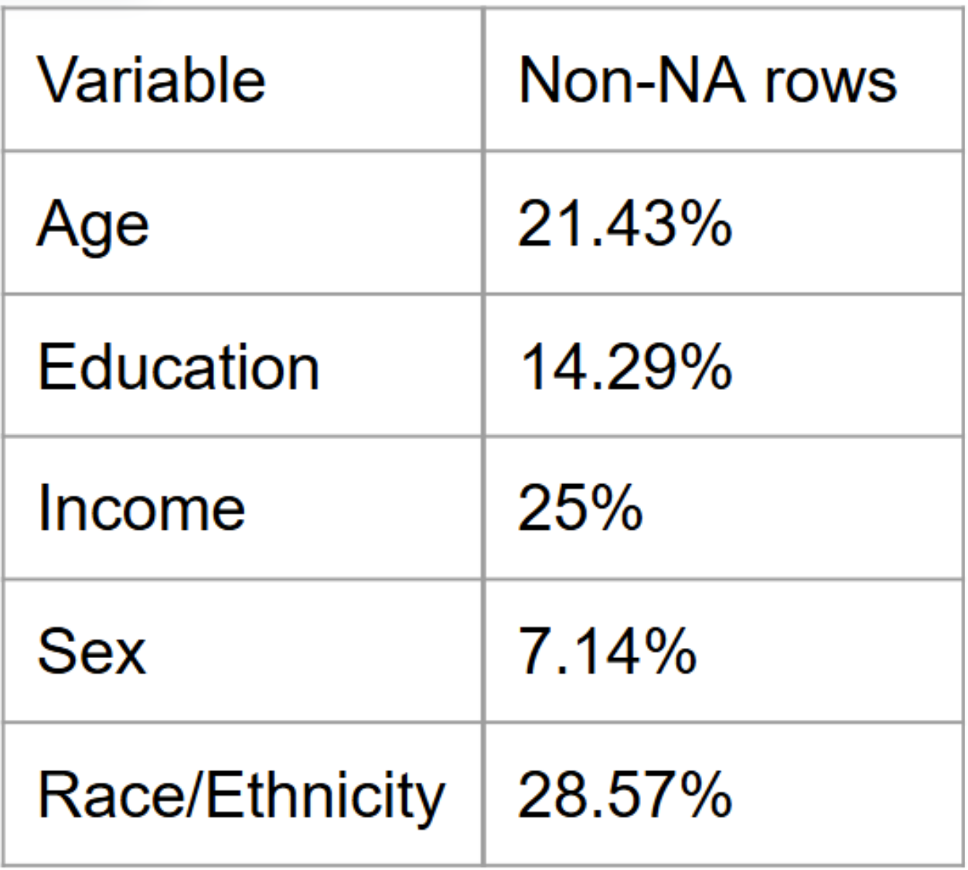
Supplementary Analysis columns
Notes:
Vincent

Slide 9
Dataset Limitations
The dataset robustly documents the information on when the aggregates were collected and their location
Demographic variables have null values for roughly 70-90% of rows
The dataset contains multiple questions on which aggregates are based on, and our analyses are based only on the question of obesity prevalence
  This leaves us with 26200 observations for each time point
Notes:
Vincent

Slide 10
Methodology
Hypothesis Testing Framework: Used hypothesis testing to compare the increase in obesity over our pre-COVID and COVID-era intervals
Bootstrap Resampling Methodology: Employ bootstrap techniques to utilize the aggregated nature of our dataset and overcome sampling disparities across states, ensuring robust statistical inference
Regional Trend Analysis: Conduct geographic analysis to identify patterns and correlations in obesity growth across different regions of the United States
Demographic Correlation Study: Investigate potential relationships between obesity trends and demographic variables, utilizing available stratified data
Data Composition Strategy: Leverage bootstrap methods to analyze all statistically viable demographic subgroups (representing 10-20% of dataset rows), overcoming sample size limitations in specific population segments
Notes:
Vincent

Slide 11
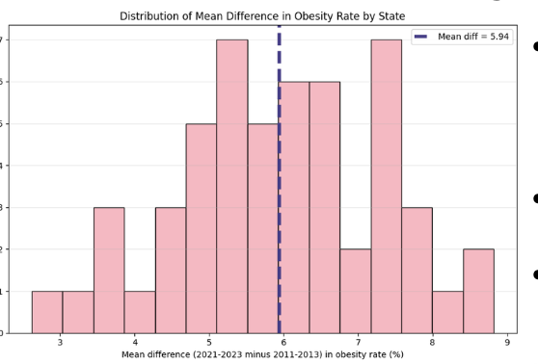
Regional Variance
Every US state/territory saw an increase in obesity between the first and third time point.
Biggest increase - New mexico, South Dakota, Oklahoma Wyoming, and Puerto Rico
Smallest Increase - DC, Michigan, Hawaii, Vermont, and California
Notes:
Tarif

Slide 12
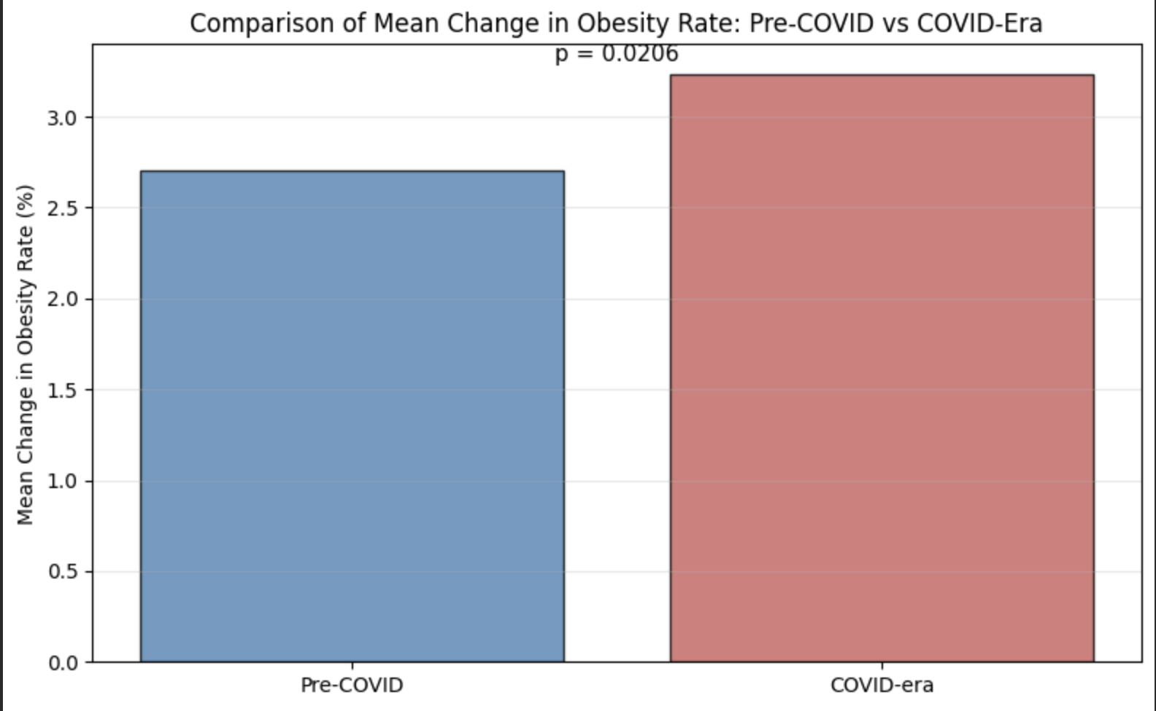
Tackling COVID-19
Method: Paired t-test to compare two sequential periods of obesity increase
  pre-COVID: 2011-2013 to 2016-2018
  COVID lockdown: 2016-2018 to 2021-2023
Results: increase in mean difference between the two periods
  t=2.39, p=0.021
  The rise in obesity was greater during COVID
Notes:
Tarif

Slide 13
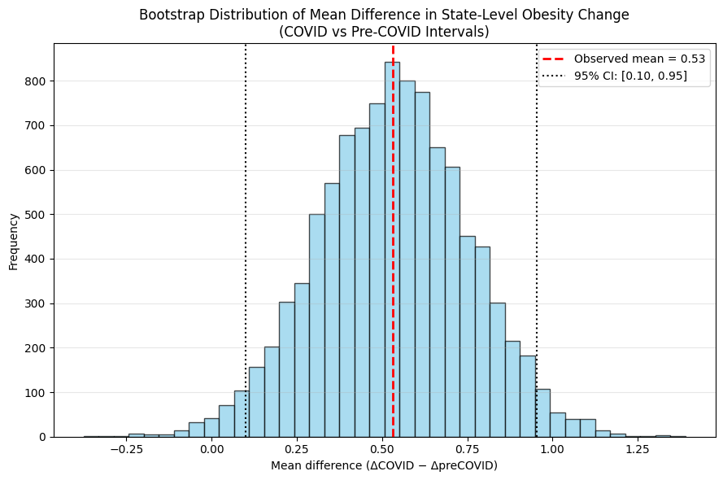
Bootstrap Analysis
To provide a robust, nonparametric complement to the paired t-test
Method: a bootstrap analysis was conducted on state-level difference
  Difference between COVID-era change and pre-COVID change was calculated for each state
  10,000 bootstrap resamples were generated by sampling these state-level differences with replacement
Results:
  95% confidence intervals
  A two tailed p-value (0.10, 0.96)
Notes:
Tarif

Slide 14
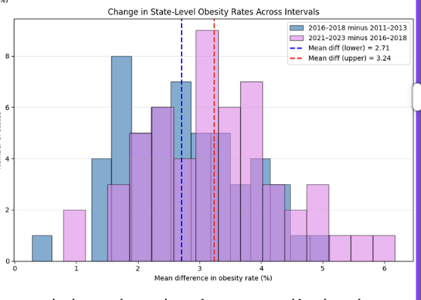
“The COVID-19 Accelerator”
Non-Linear Growth: Obesity rates did not rise at a steady pace. The average increase was significantly greater during the COVID interval (2021-2023) compared to pre-COVID.
Notes:
Tarif

Slide 15
Socioeconomic Factor - Analysis
Data Source: Analyzed aggregate estimates from the BRFSS, which are sample-weighted proportions for specific subpopulations (e.g., age group, income).
Analysis Steps:
  For each demographic group, computed a weighted mean obesity proportion for each of the three intervals (2011–2013, 2016–2018, 2021–2023), using the reported sample sizes as weights.
  Calculated difference scores for the changes between these intervals (early→middle and middle→late).
Quantifying Uncertainty:
  Primary Method: Used a binomial standard-error approximation, using the sample sizes provided alongside each survey aggregate
  Robustness Check: Also generated nonparametric bootstrap confidence intervals by resampling aggregates within each interval.
Core Test: Conducted Difference-in-Differences (DiD) tests for each subgroup to determine if the change in obesity rates accelerated or slowed between the two consecutive time intervals.
Notes:
Vincent

Slide 16
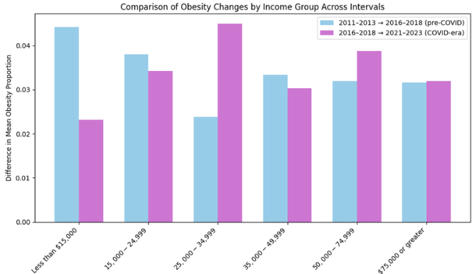
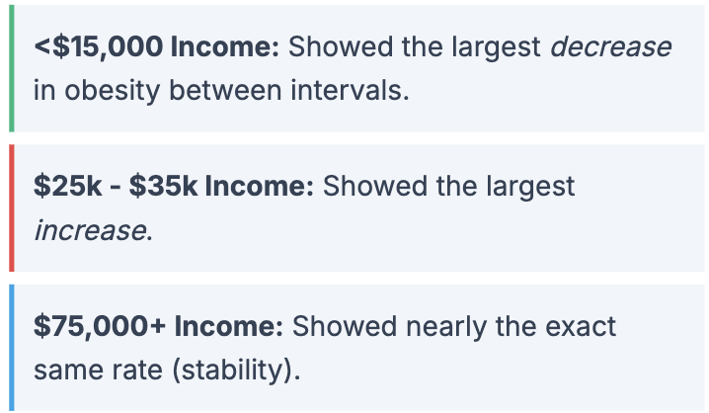
Effect of Income
Contrary to simple linear assumptions, the change in obesity rates varied uniquely by income brackets:
Notes:
Tarif

Slide 17
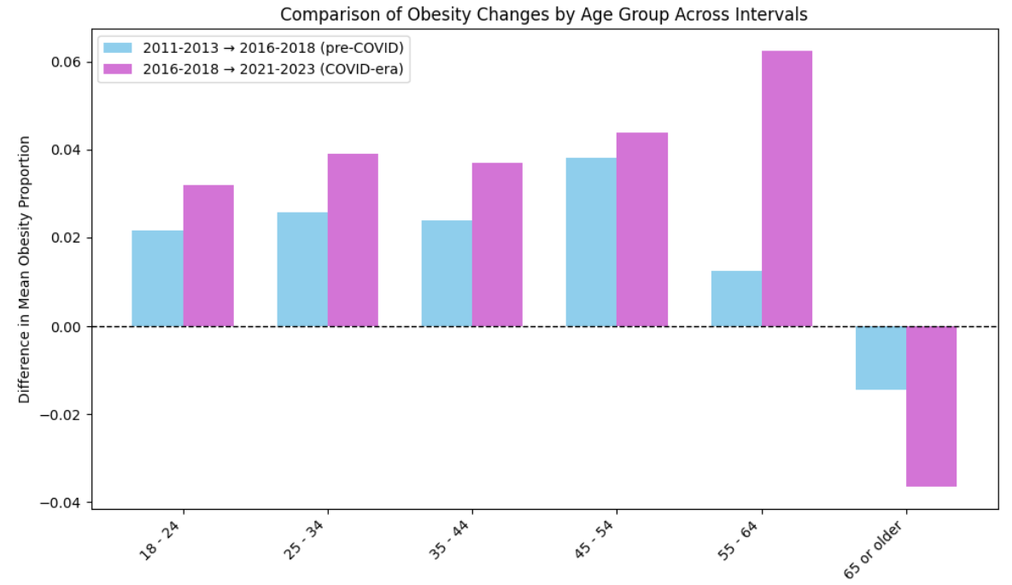
Effect of Age
For each age group, the weighted mean obesity of the three time time interval was computed
Key pattern: younger and middle aged adults generally experienced large obesity increase
Younger Adults (18-44): The COVID-era increase was roughly 1.5 times larger than the pre-COVID increase.
55-64 Year Olds: Showed the largest COVID-era increase of all groups, but the smallest pre-COVID increase.
65+ Year Olds: Exhibited decreases in both periods, with a larger decline during the COVID-era.
Notes:
Tarif

Slide 18
Effect of Race
Method: Applied a difference-in-differences (DiD) framework to three intervals. For each racial/ethnic group, we calculated:
Weighted mean obesity prevalence per interval.
Two change scores: pre-COVID change and COVID-era change
Statistical Assessment: Evaluated changes using standard errors and bootstrap confidence intervals.
General Pattern: Most groups experienced very similar increases across both time periods, suggesting a consistent, underlying growth trend.
Notes:
Vincent

Slide 19
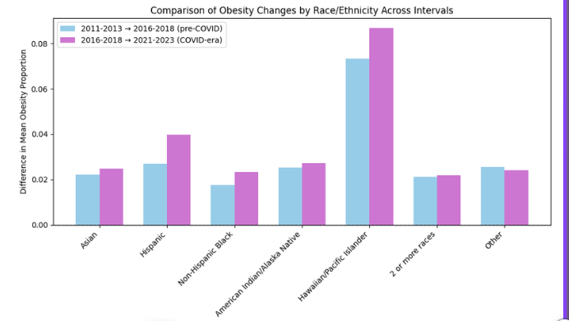
Notable Exceptions to Race
Hispanic Individuals: Experienced a modestly larger increase in both periods compared to other groups.
Hawaiian/Pacific Islander Group:
  Exhibited much higher absolute obesity levels and noticeably larger increases across both intervals.
  Both change score bars were substantially taller, indicating higher baseline prevalence and steeper growth.
Statistical Significance: Despite these observable patterns, none of the comparisons reached statistical significance.
Notes:
Vincent

Slide 20
Conclusion
Obesity increased faster during the period leading into COVID-19 lockdowns compared to the pre-COVID interval
  COVID-19 exacerbated obesity trends, OR obesity increases naturally follow a nonlinear (e.g., exponential) trajectory
Obesity consistently increases across all US states and territories
Future pandemics/lockdowns have more variable effects on obesity rates for lower-income individuals, while higher-income groups show fewer deviations compared to typical rates
Younger individuals show more consistent obesity trends, while older individuals have higher variations and show larger effects from COVID-19 lockdowns
Obesity trends and COVID-19 impacts are relatively similar across races/ethnicities, although Hawaiian/Pacific Islander have a much higher base rate
In future crises, more targeted nutritional aid should be provided to lower-income groups and elderly populations
More affordable and convenient nutritional and non-processed foods should be prioritized through government subsidies especially in times of crisis to bolster the health and wellbeing of Americans
Notes:
Vincent

Slide 21
Reference
Stierman B, Afful J, Carroll MD, et al. National Health and Nutrition Examination Survey 2017–March 2020 pre pandemic data files development of files and prevalence estimates for selected health outcomes. Natl Health Stat Report. 2021;158.
Ward ZJ, Bleich S, Long MW, Gortmaker SL. Association of body mass index with health care expenditures in the United States by age and sex. PLoS One. 2021;16(3):e0247307. doi: 10.1371/journal.pone.0247307
Centers for Disease Control and Prevention. Nutrition, Physical Activity, and Obesity: Behavioral Risk Factor Surveillance System. CDC, https://data.cdc.gov/Nutrition-Physical-Activity-and-Obesity/Nutrition-Physical-Activity-and-Obesity-Behavioral/hn4x-zwk7.

